Slide 1
Order Management
Application
-Anirudh Agarwal
46022740

Slide 2
Overview
The Order Management Application is a Cloud based Salesforce application which allows the user to search for the products they want to buy based on the name, brand and price range of the products along with provision to specify quantity of the products. Depending on the user’s profile, they are permitted to view, create, edit or delete data in the organization. This application also notifies selected users when an order status is updated via in-app notifications and emails.

Slide 3
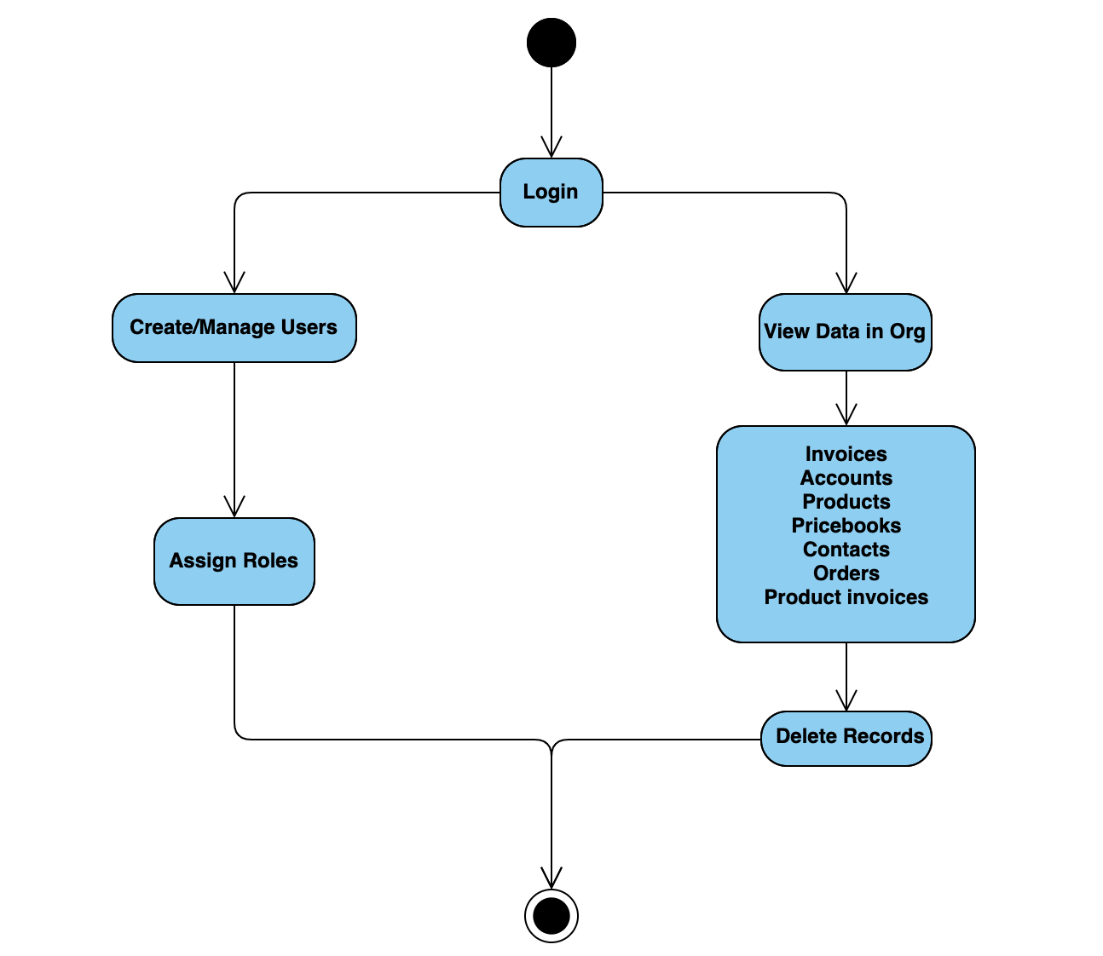
Support Team:
The Support Team can :
Create/Manage Sales users and Business users.
Assign roles to the created users.
Can view all the data on the application.
Can delete records on the application.

Slide 4

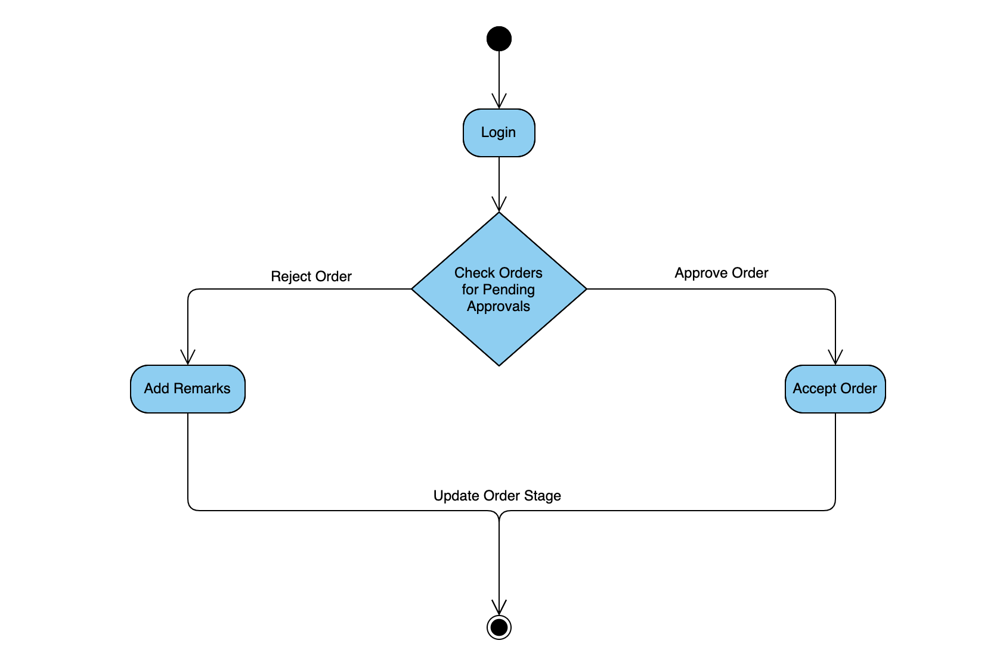
Business Users
The Business user can :
Can manage upto 2 Sales Users.
View the accounts, related contacts, orders and invoices only.
Approve the orders booked by the sales user when the order
amount is greater than 100000.

Slide 5
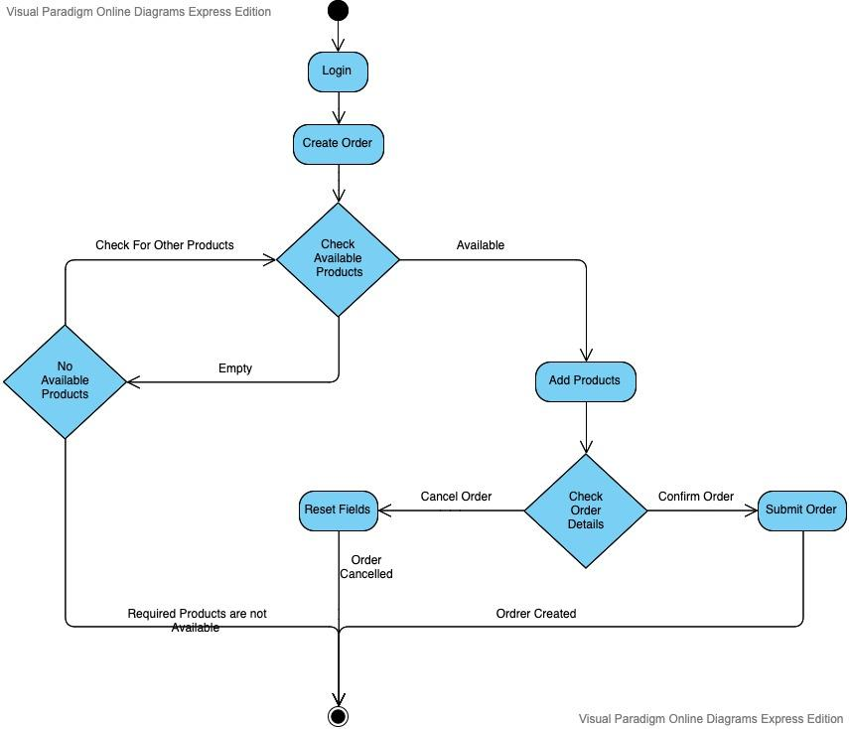
Sales Users:
The Sales user can :
Can Manage upto 5 Accounts and can view the data related to its Accounts only.
Create new Orders.
Search for the products after creating an Order.
Specify the quantity of each product and discount as well.
Remove the selected products from the list before booking.
View the bookings of the orders made by them only.
Create invoices for the products and order as well.

Slide 6
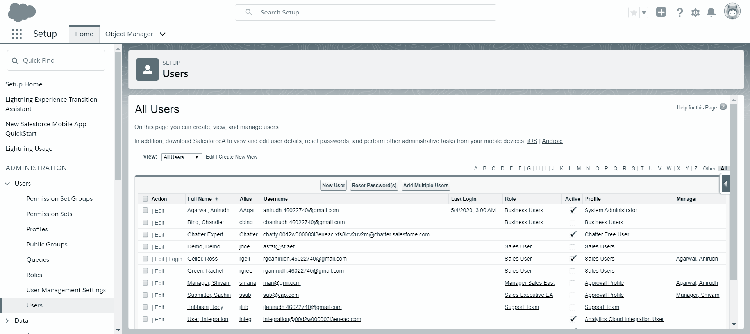
Logging in as a Sales User:

Slide 7
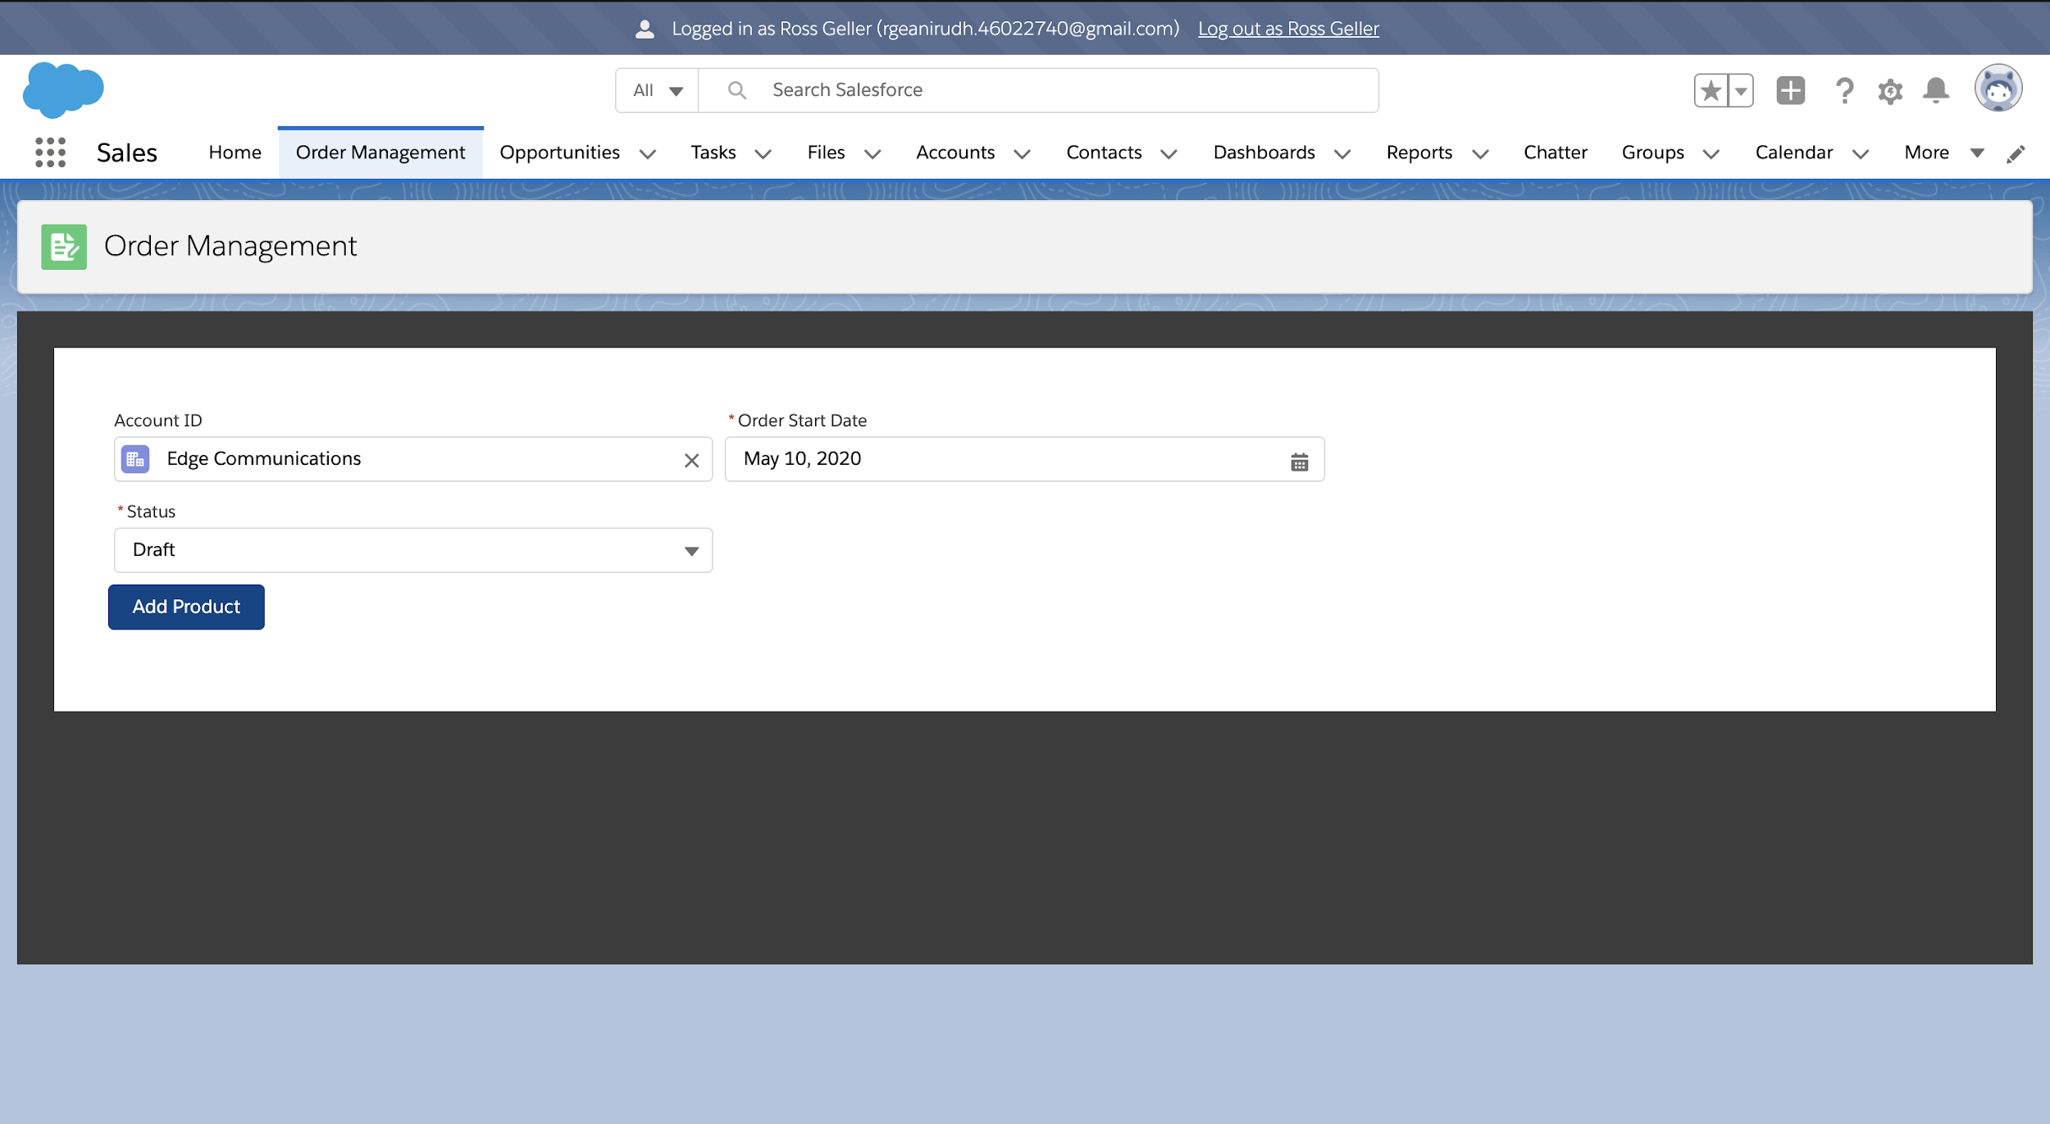
Creating a new Order:

Slide 8
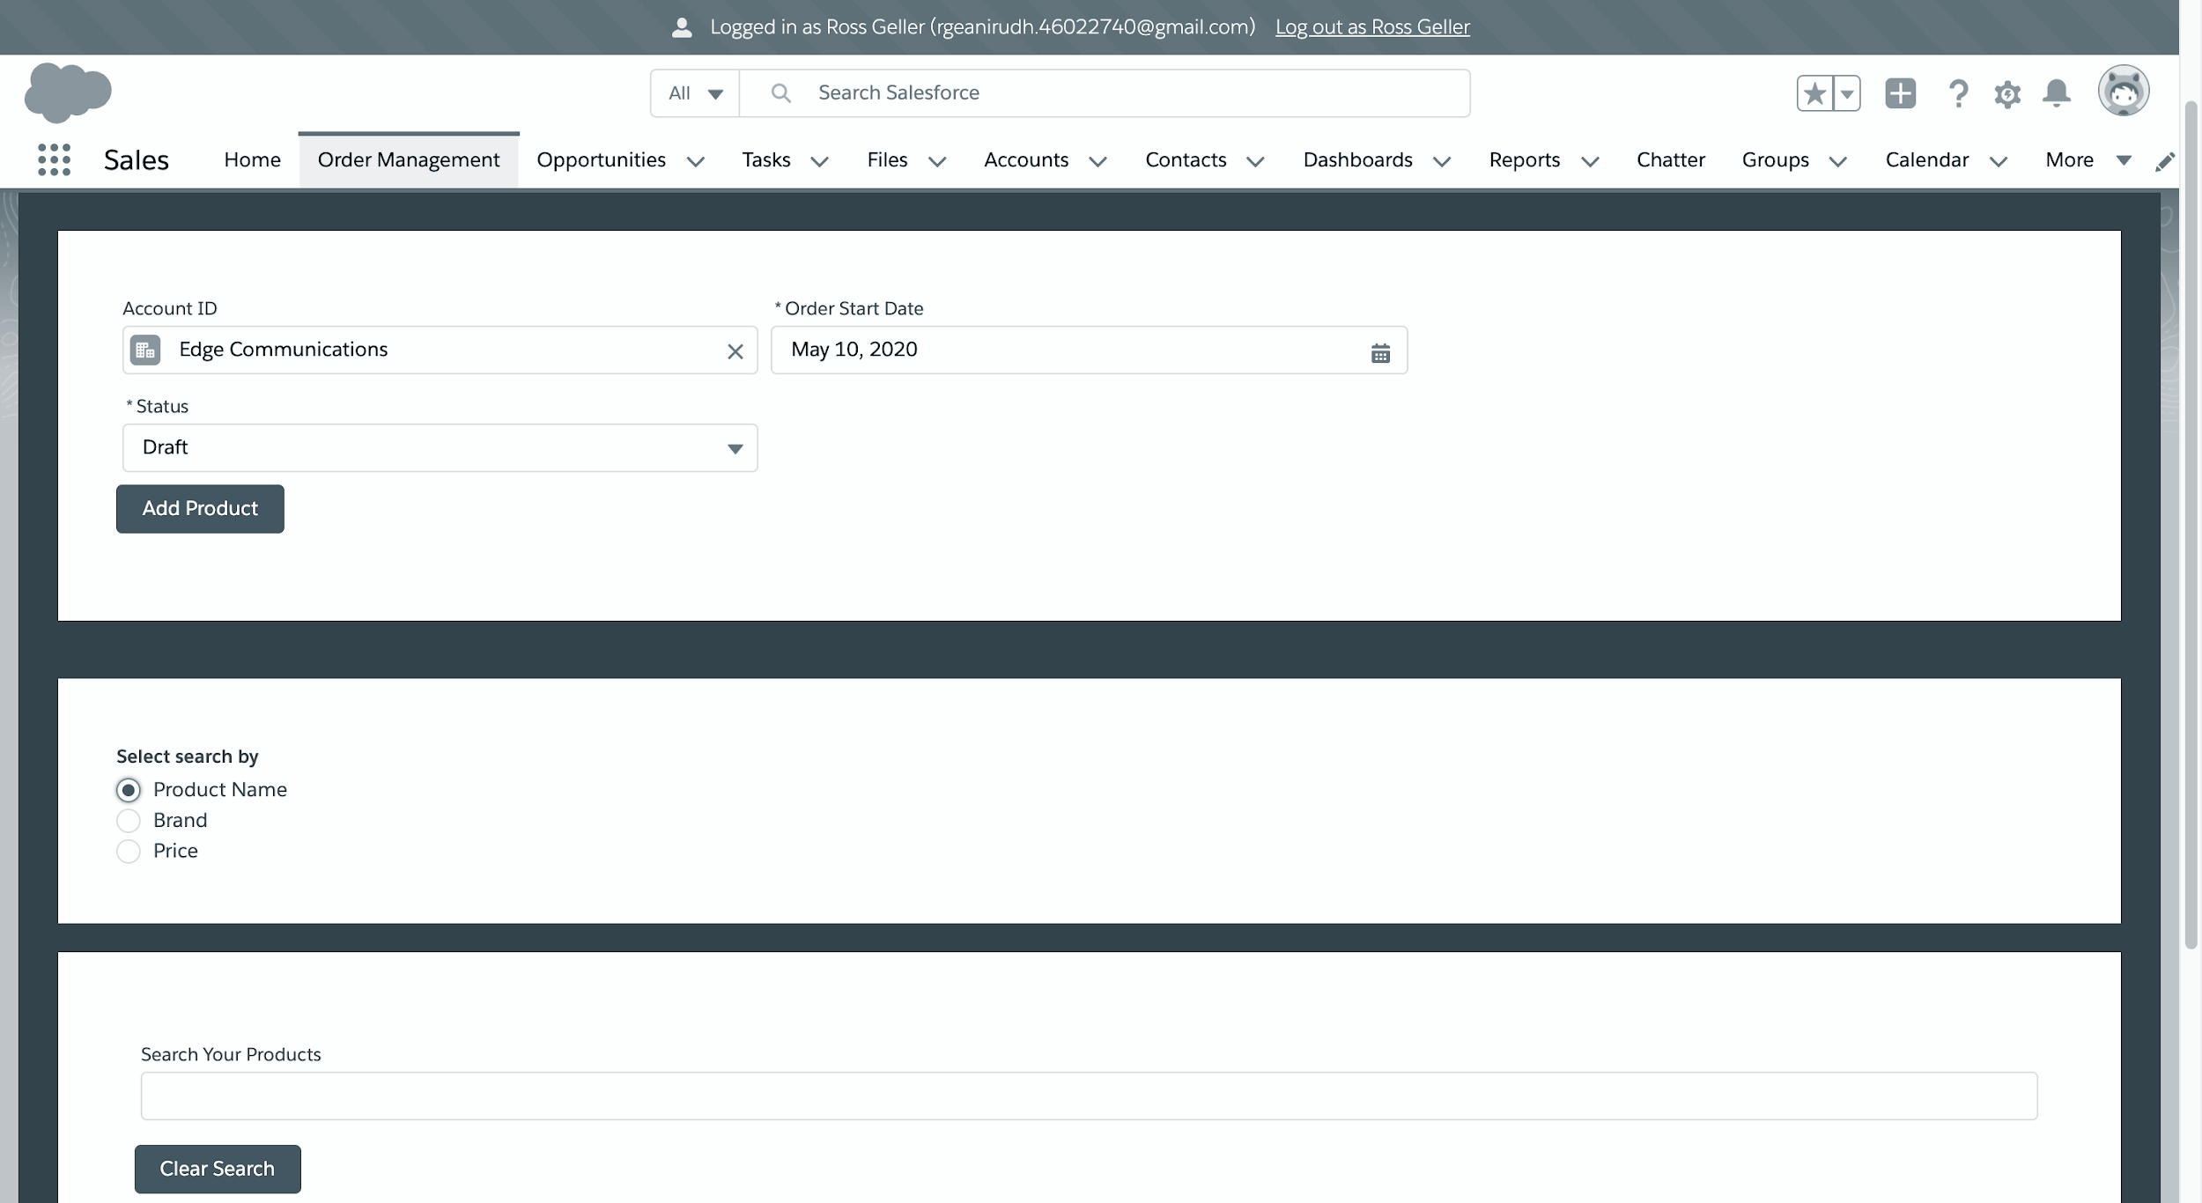
Selecting the option to search products by:

Slide 9
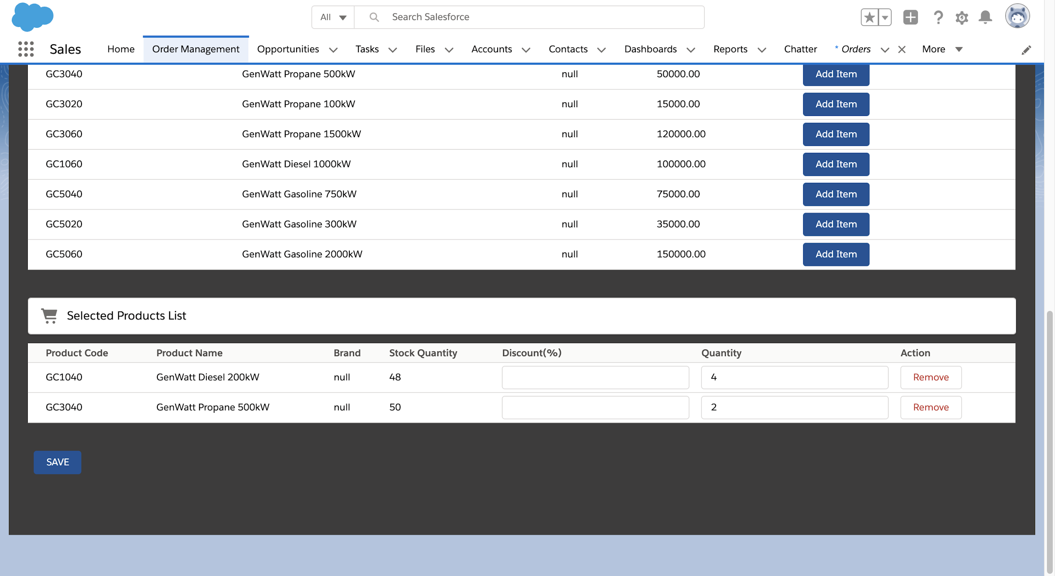
Showing the List of Added Products:

Slide 10
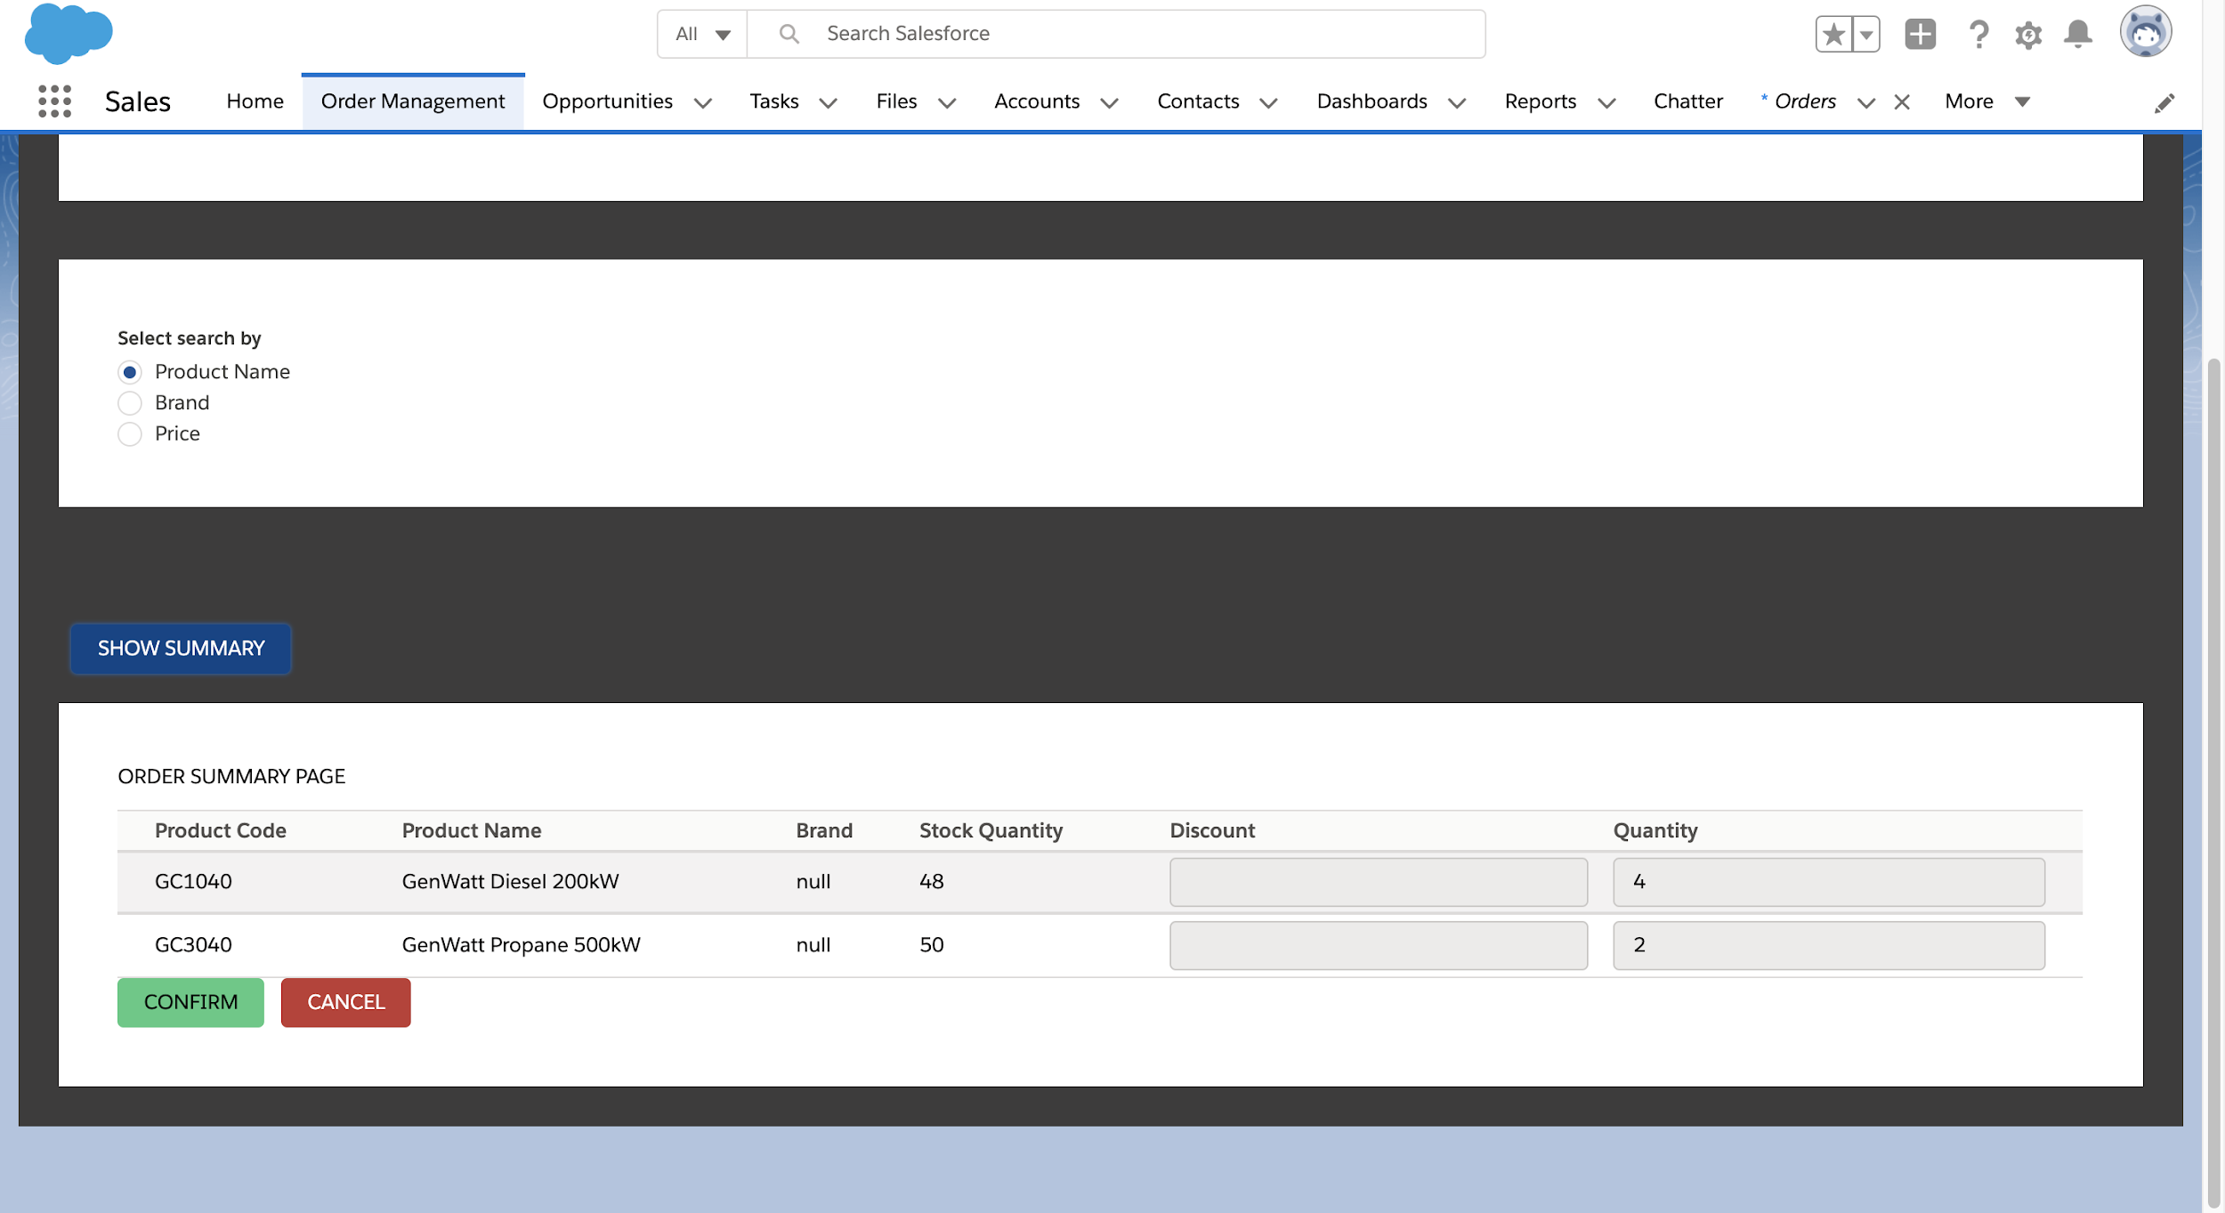
Summary Page:

Slide 11
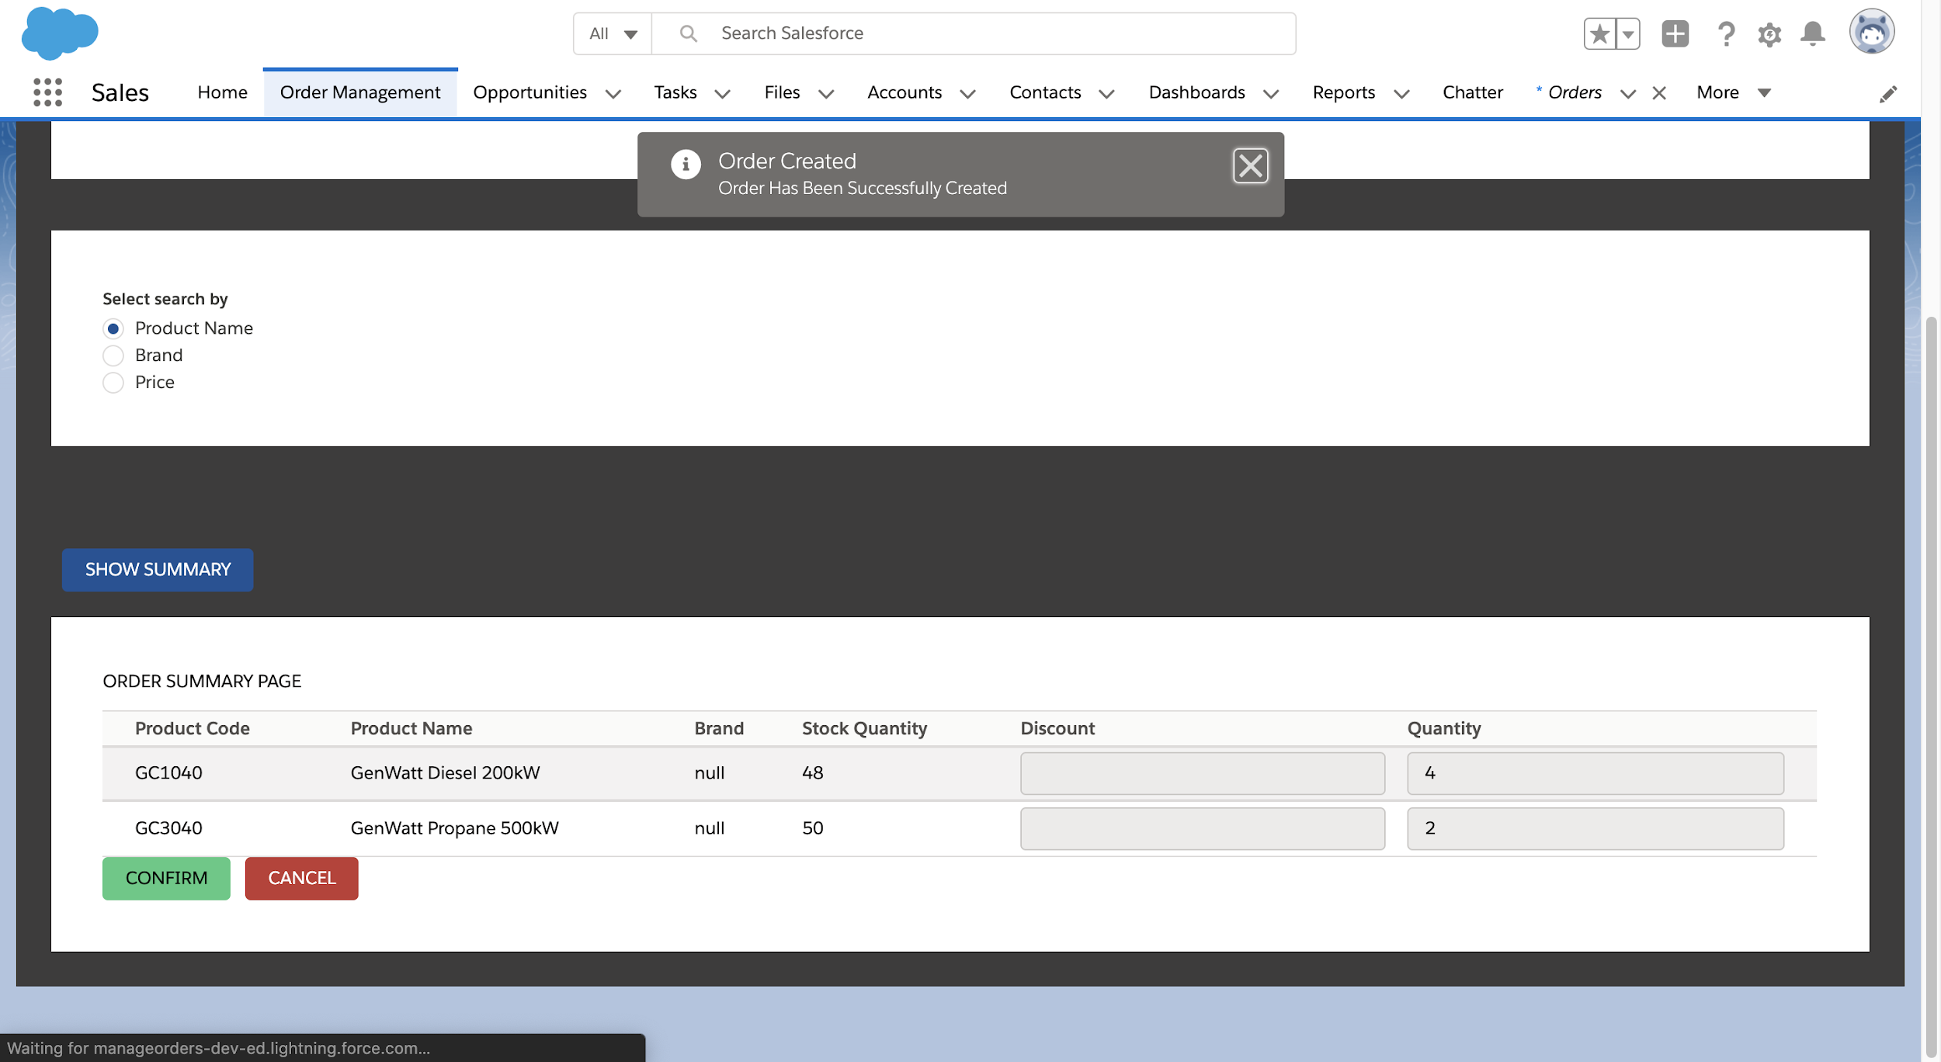
Confirming the Order:

Slide 12
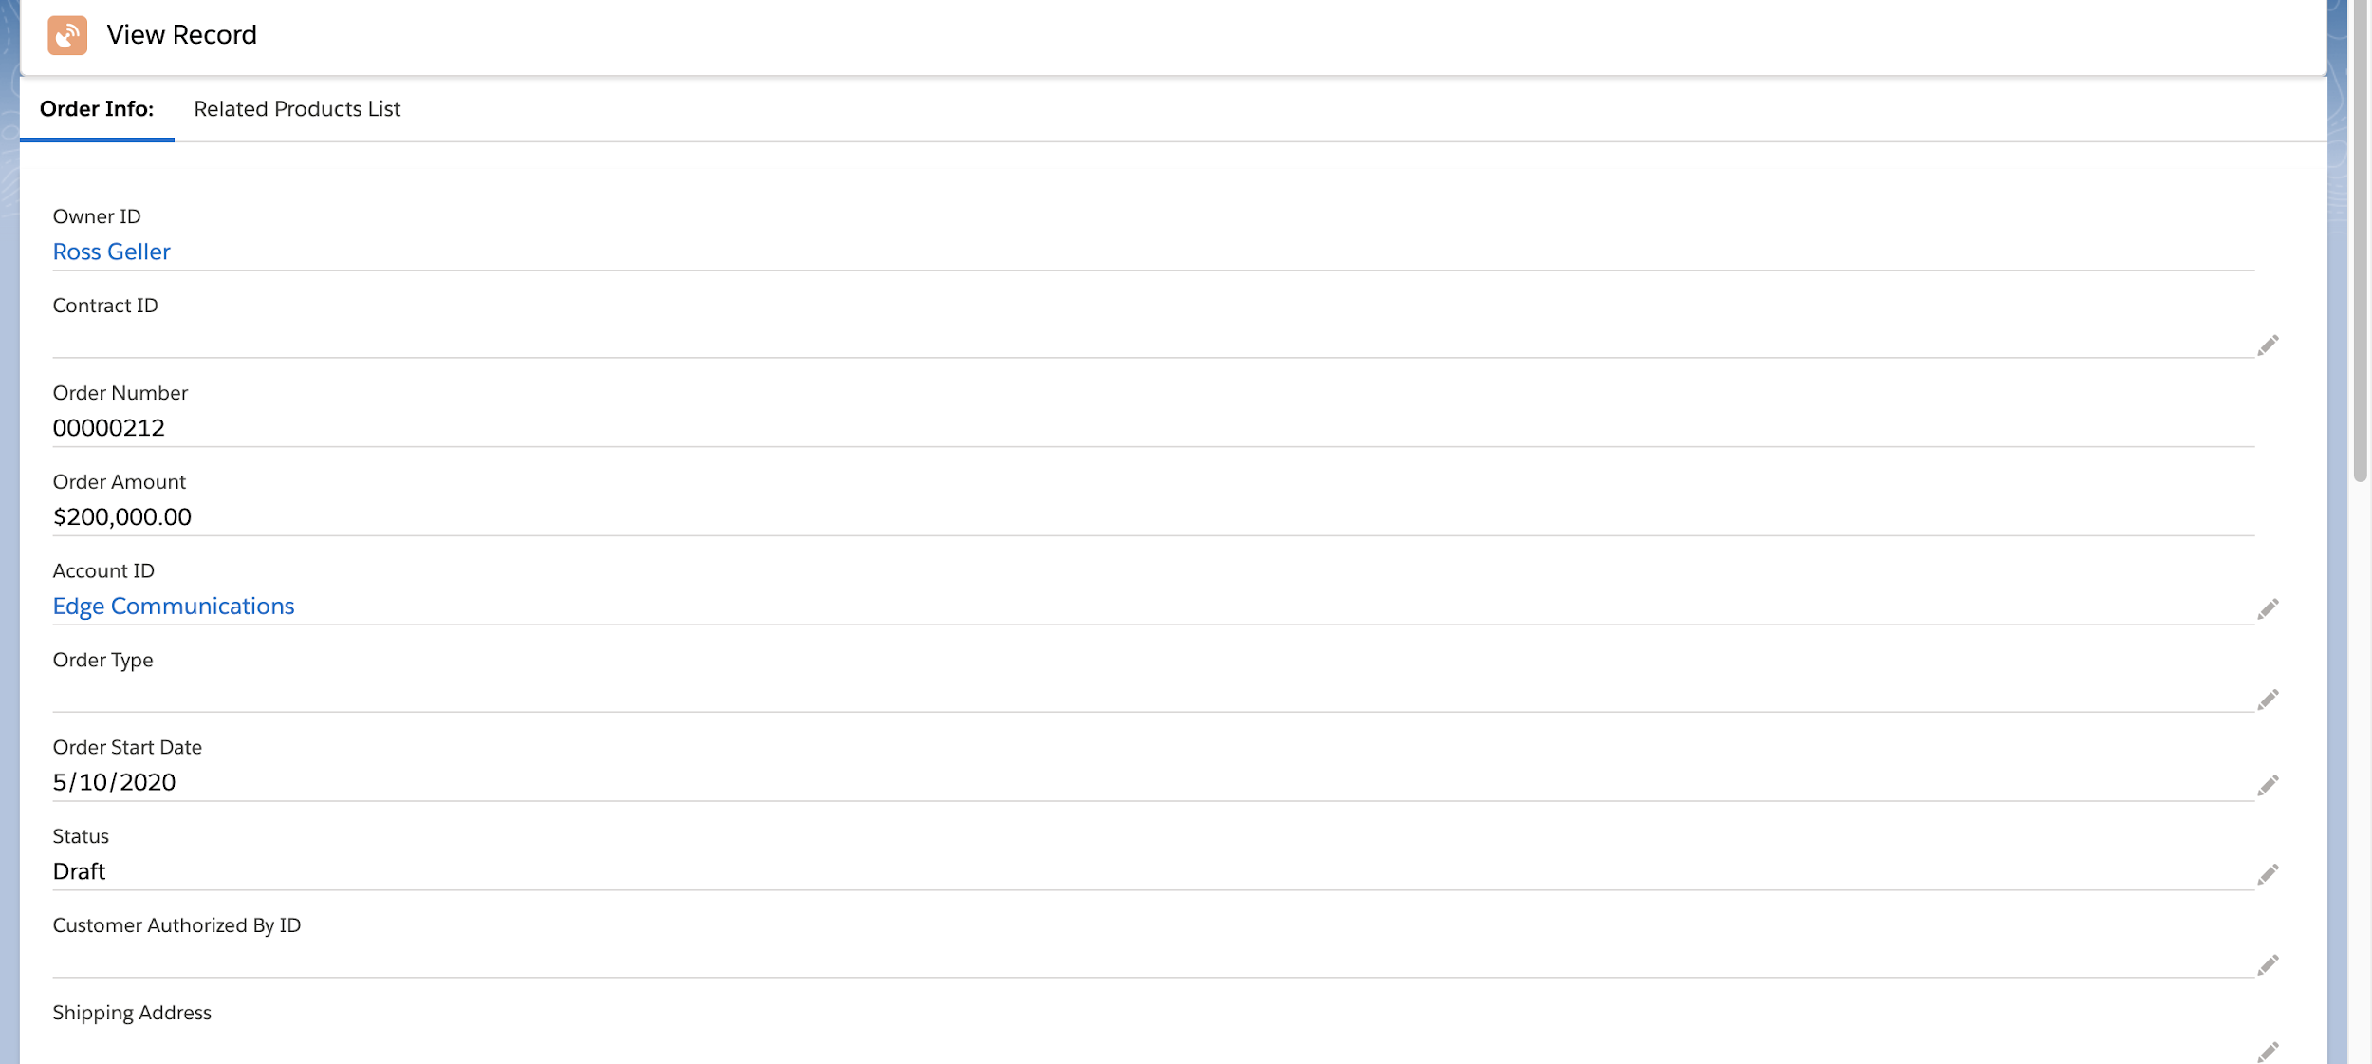
Order View Page:

Slide 13
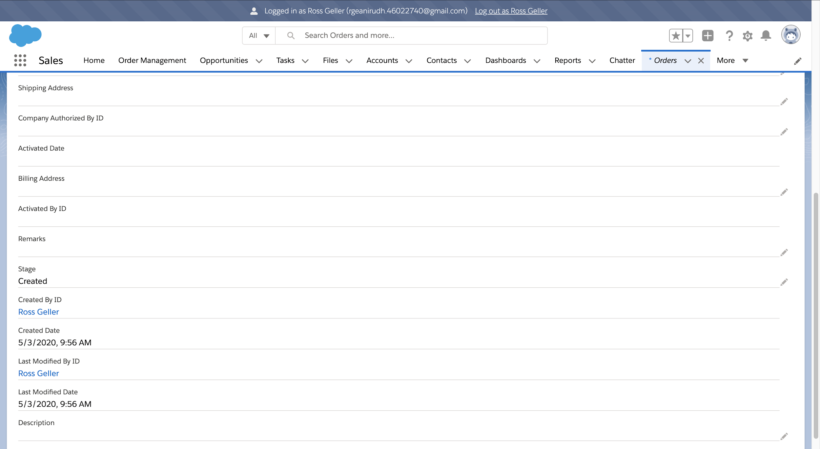
Order Waiting for Approval:

Slide 14
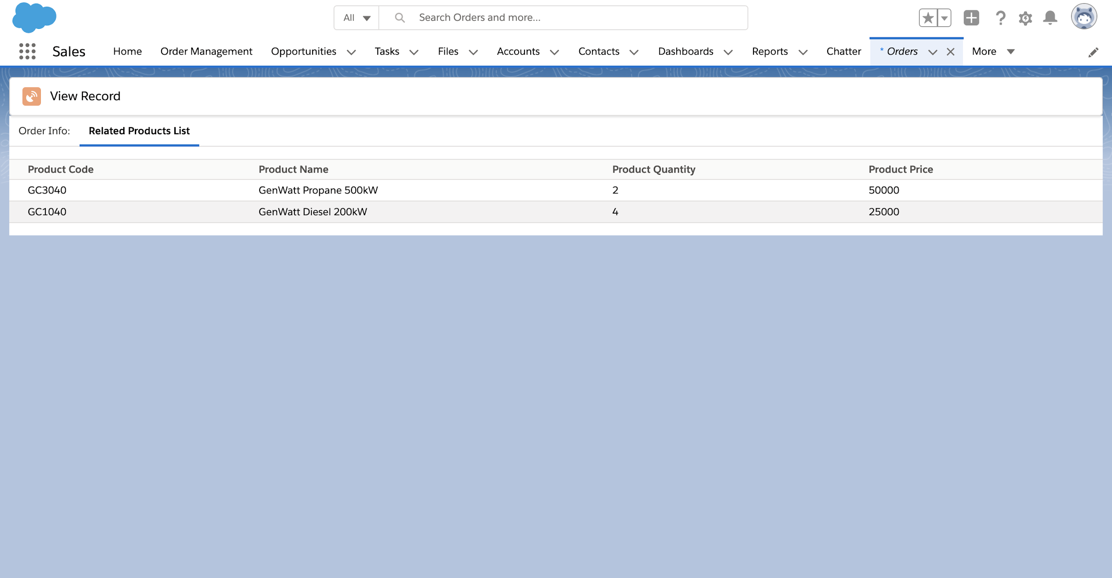
Order Products List:

Slide 15
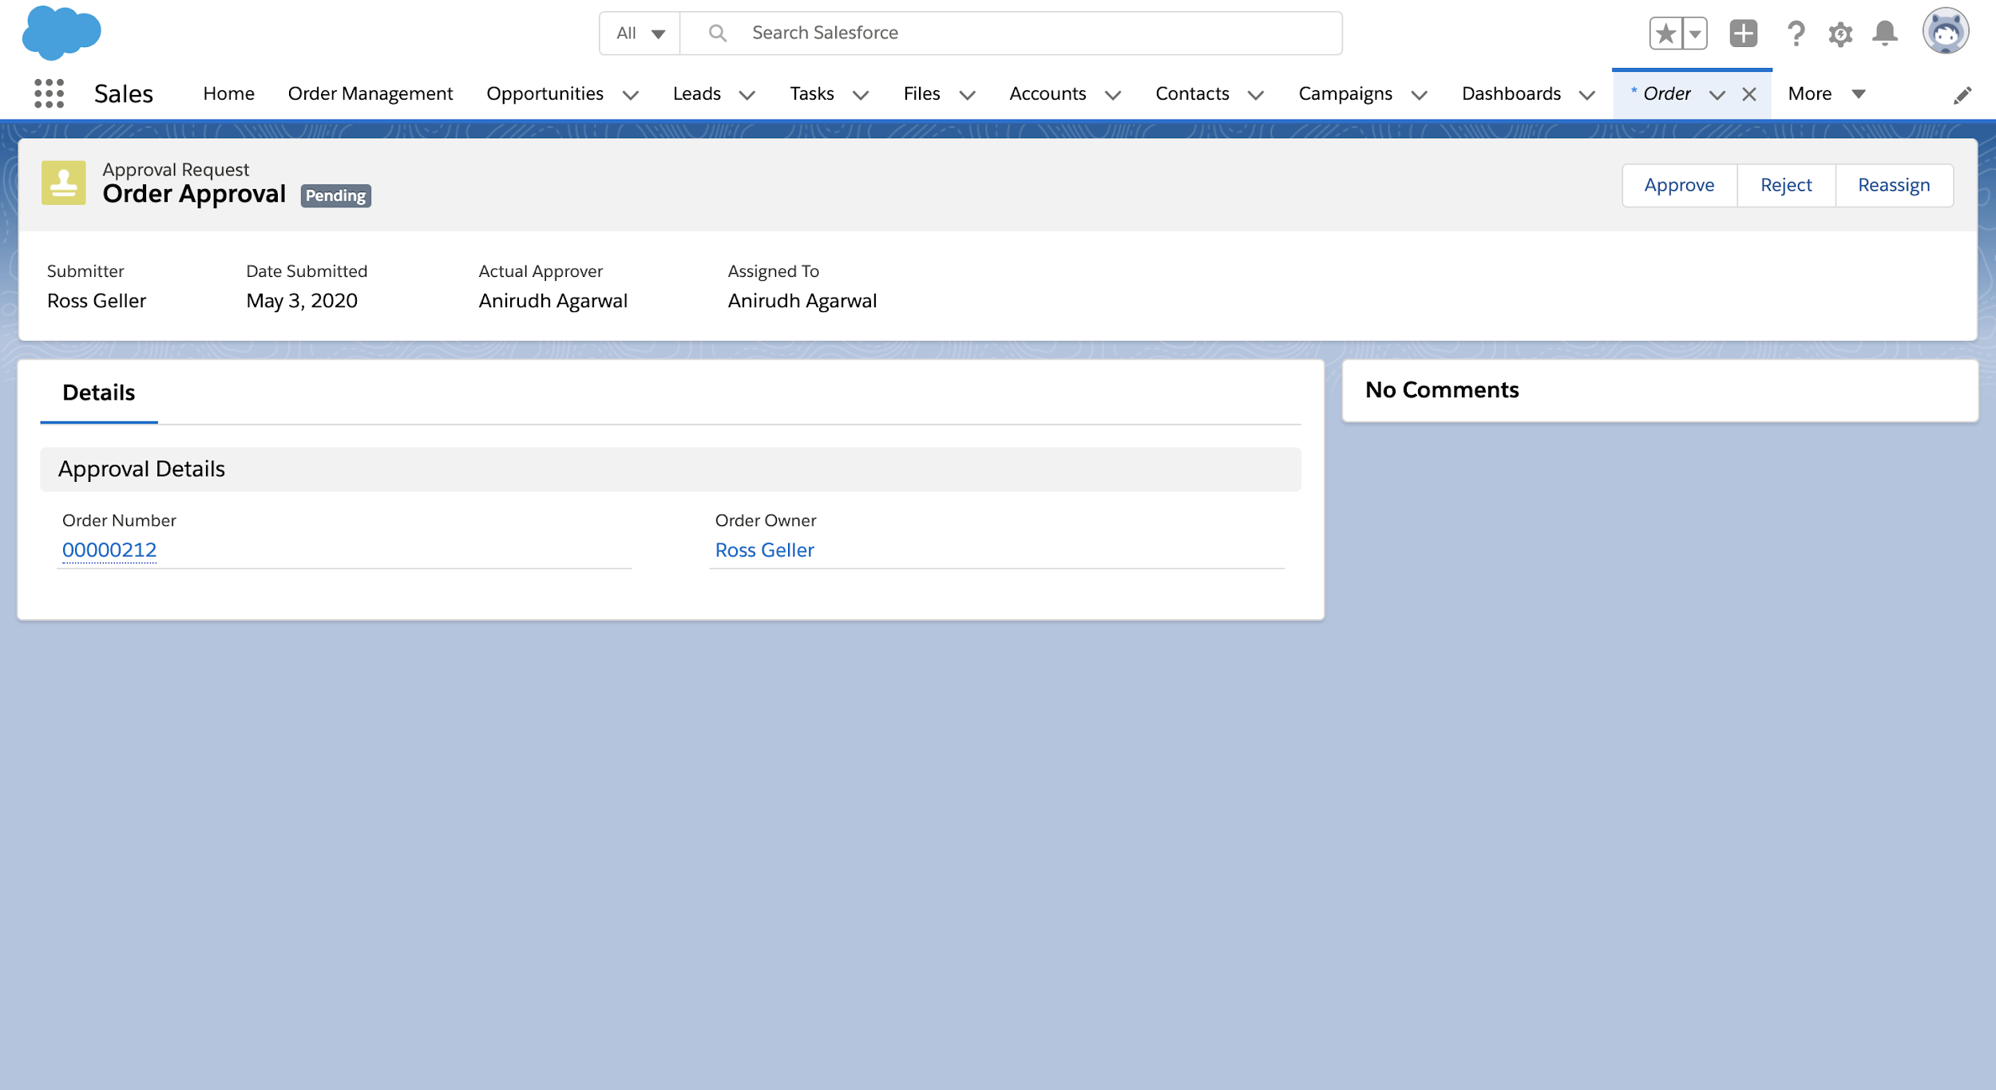
Order Approval Page:

Slide 16
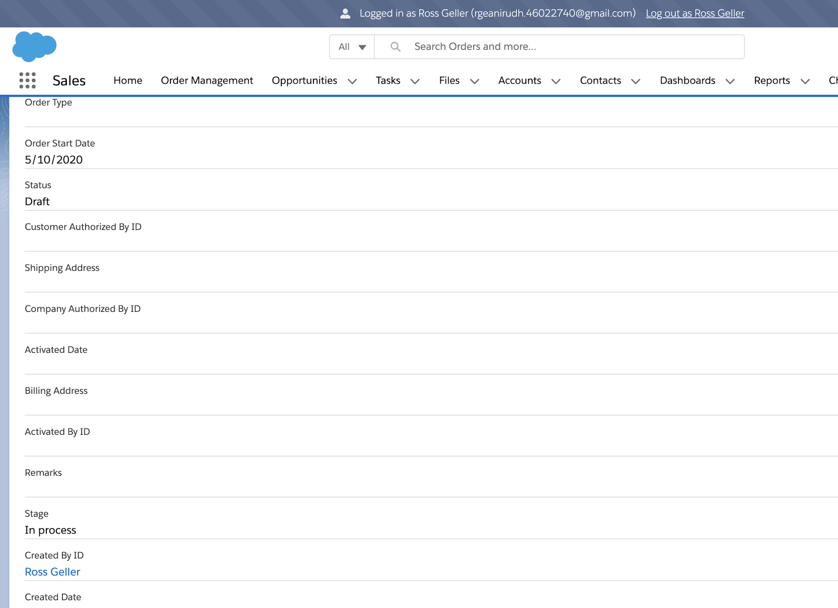
Order Stage has been Updated after Approval

Slide 17
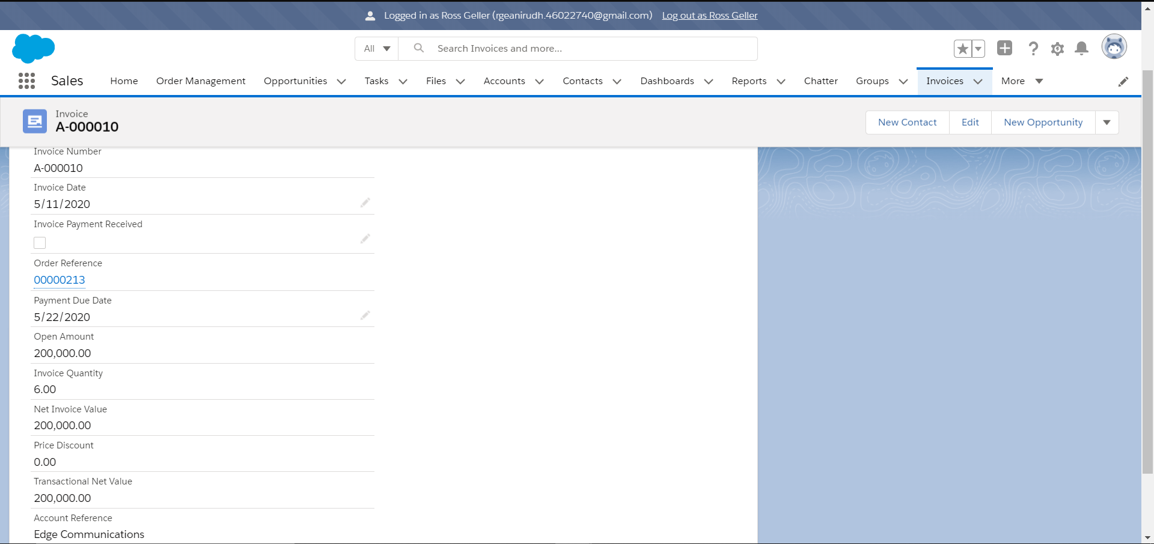
Invoice Generated for the Order:

Slide 18
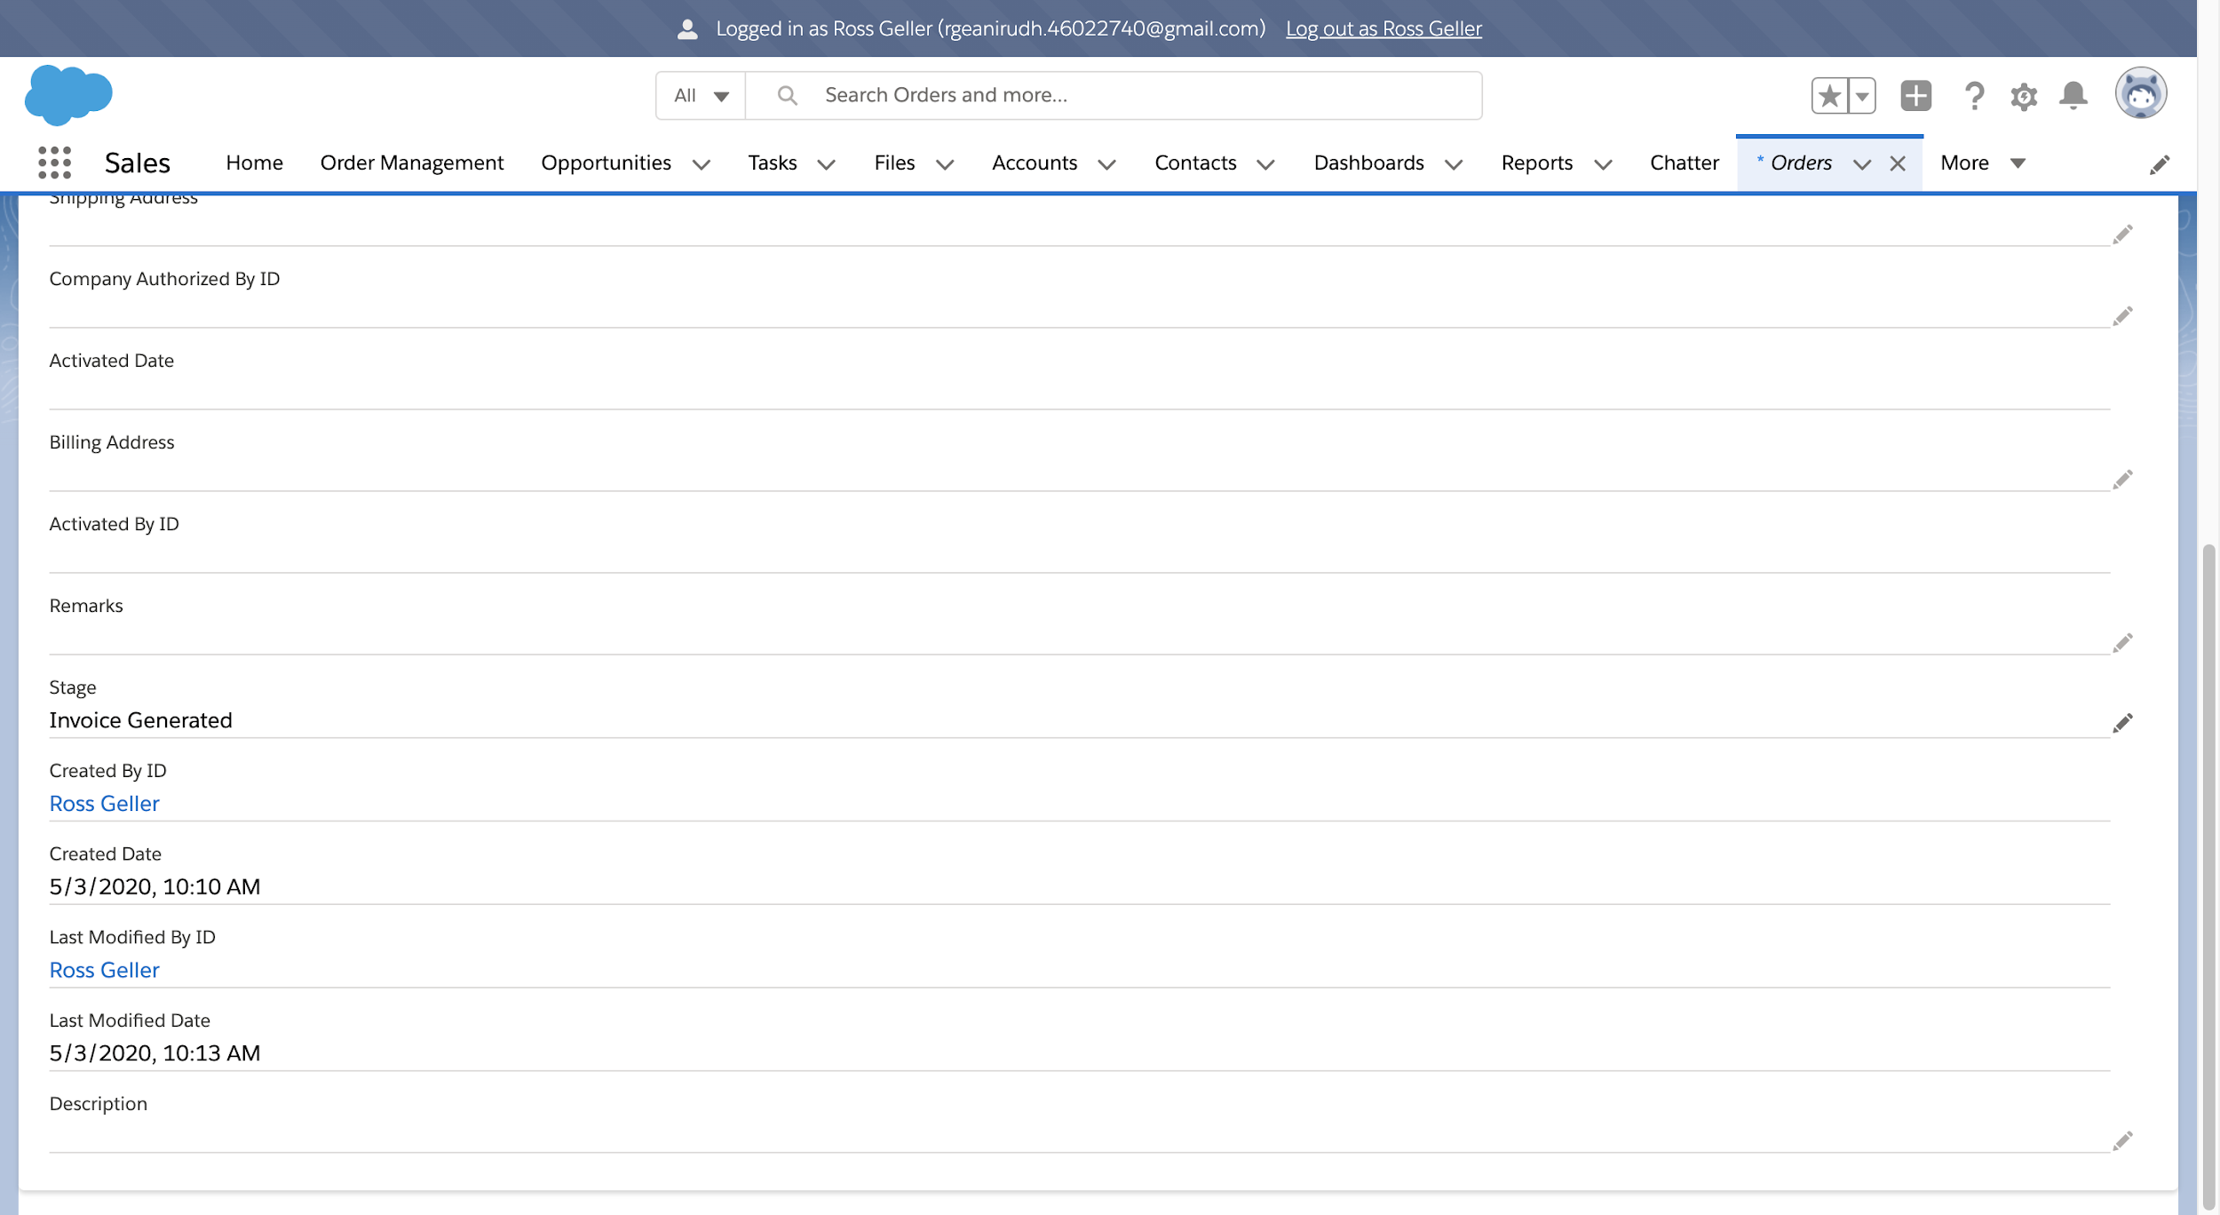
Order Stage Changed to Invoice Generated:

Slide 19
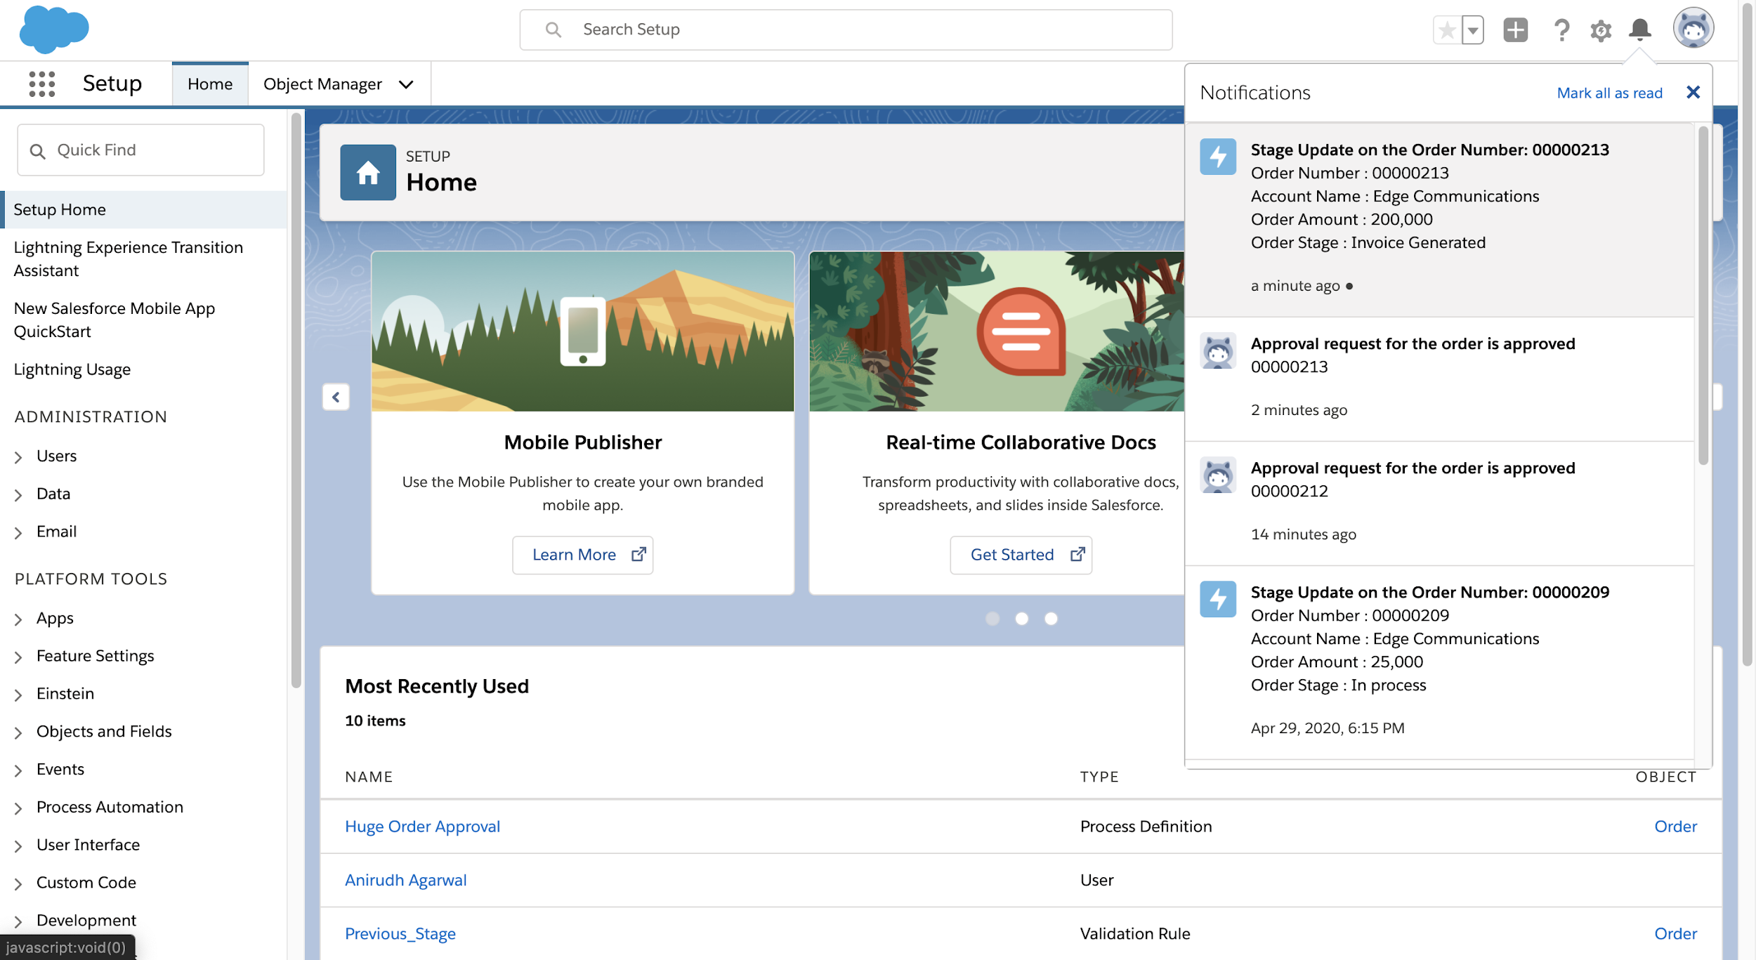
In App Notification for the Order Update:

Slide 20
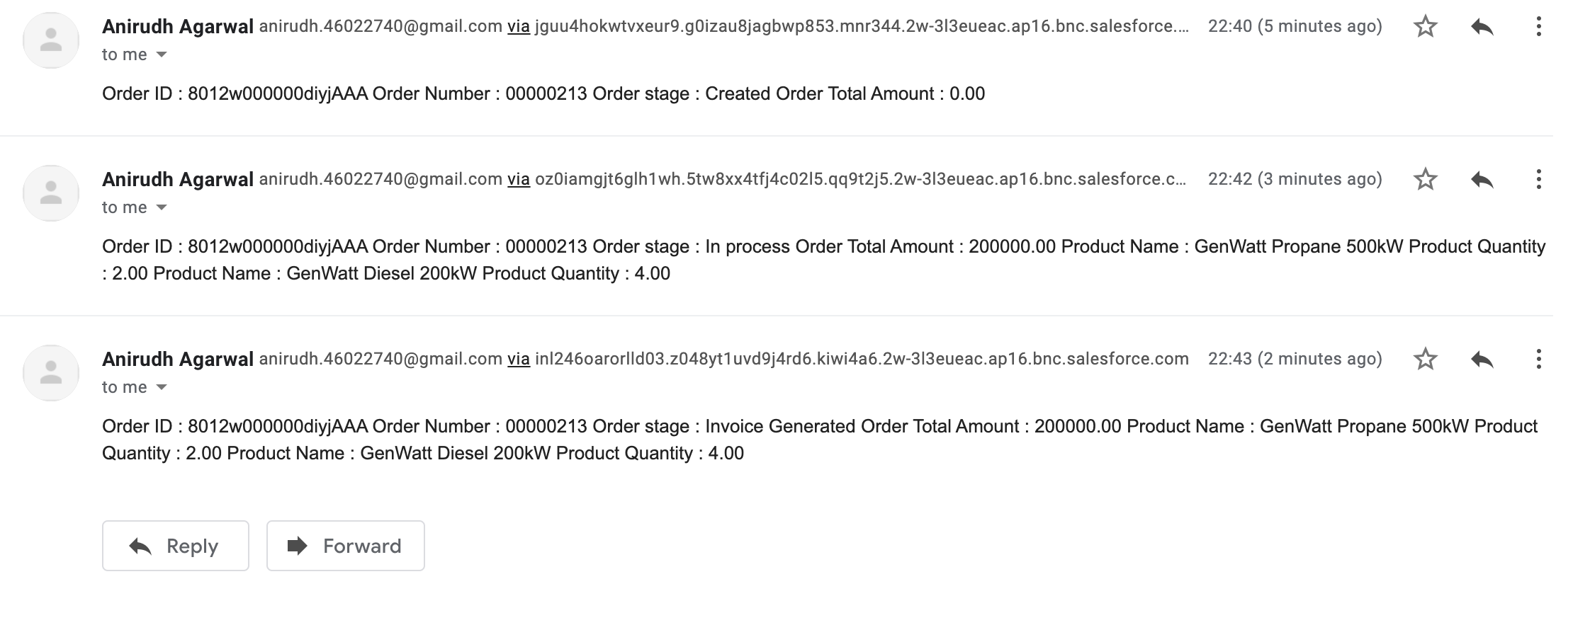
Mail to the Contacts regarding Stage Update:

Slide 21
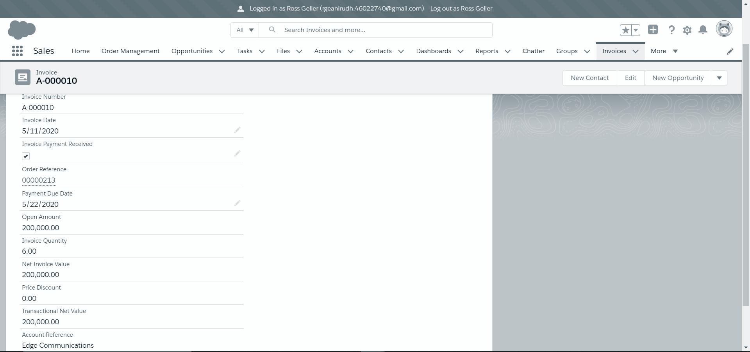
Invoice Payment Received:

Slide 22
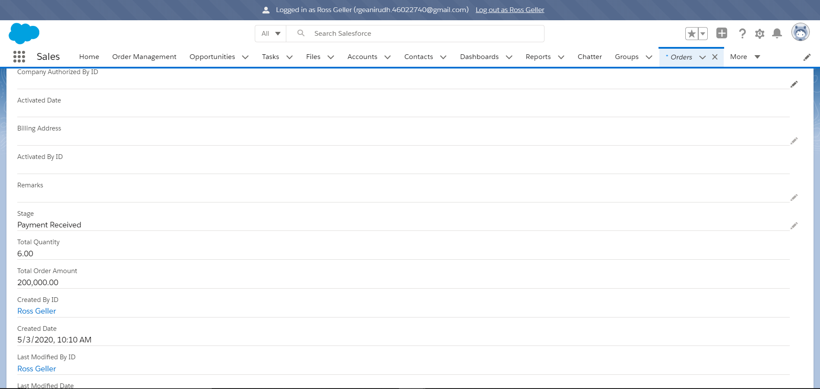
Order Stage Changed to Payment Received:

Slide 23
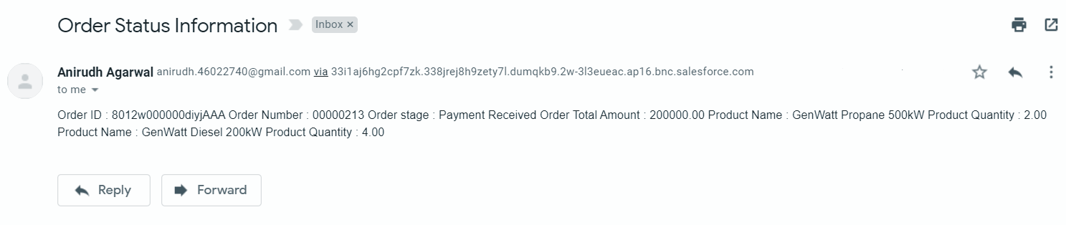
Mail to the Contacts regarding Stage Update:

Slide 24
Validations:
Sales User cannot create more than 5 accounts.
Trigger used on Account standard object.
Business User cannot be a manager for more than 2 Sales Users.
Trigger used on User standard object.
The stage of the order cannot be modified to its previous stage.
Trigger used on the Order standard object.
Remark is compulsory when the stage of the order is cancelled.
Validation rule on Order standard object.
Invoice Created Date Cannot Be Before Order Start Date
Validation rule on Invoice custom object.
Payment Due Date Cannot Be Before Invoice Created Date.
Validation rule on Invoice custom object.

Slide 25
Outscope:
The following functionalities have not been covered under the application:
The application does not cover the payments of orders.
Invoice creation is not automated.
Transportation and shipping of products is not covered.
Once the Products have been added to the Order, products cannot be changed, edited or deleted.

Slide 26
THANK YOU !

